Slide 1

The Sprint Review

Slide 2
Objectives
To Understand
The Sprint Review
The Roles that should attend

Slide 3
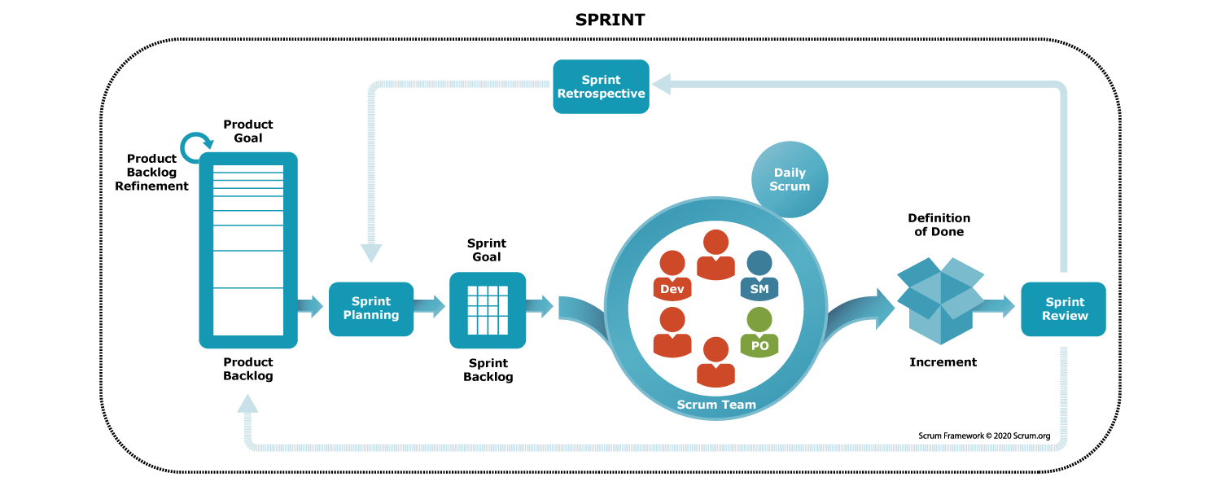
The sprint review
A review is held at the end of the sprint
Notes:
Picture from https://www.scrum.org/resources/introduction-sprint

Slide 4

Is held at the end of the sprint to inspect the work done and adapt the product backlog.
The following roles should attend
The development team
Product owner
Scrum Master
Key stakeholders
The sprint review

Slide 5
The Sprint Review
In the sprint review meeting:
The development team demonstrates what work was done, and answers any questions
The product owner discusses the product backlog as it stands
The entire group collaborates on what to do next, to provide valuable input to future sprint planning

Slide 6
Sprint Review meeting in Agile Scrum
Demo the work to the stakeholders: The features and user stories completed during the sprint.
Achievements: Celebrate successes and recognize team members for their efforts
Feedback: Collect feedback from stakeholders to identify what worked well and what could be improved.
Review of User Stories: Discuss each user story and assess if the acceptance criteria were met.

Slide 7
Sprint Review meeting in Agile Scrum
Product Owner Updates: Updates on the Product Backlog and adjusts priorities based on market conditions or feedback.
Demonstration of Increments: Show any extra development that was not part of the user stories such as infrastructure improvements.
Acceptance or Rejection of Work: Stakeholders may formally accept or reject the work done.
Discussion on Unfinished Work: Items that were planned but were not completed and potential adjustments for future sprints.

Slide 8
Sprint Review meeting in Agile Scrum
Metrics and Performance: Share relevant metrics, such as velocity.
Next Steps and Planning: Discuss the plan for the next sprint.
Feedback on the Process: Collect feedback on the overall Scrum process, impediments or challenges faced during the sprint.
Risks and Dependencies: Discuss any risks or dependencies that may impact future sprints. Develop strategies to mitigate these risks.

Slide 9

Review
You Understand
What is The Sprint Review is
The Roles who should attend
How the sprint review is used to increase collaboration

Slide 10


Lab
Complete Lab10
Duration 30 minutes

